Slide 1
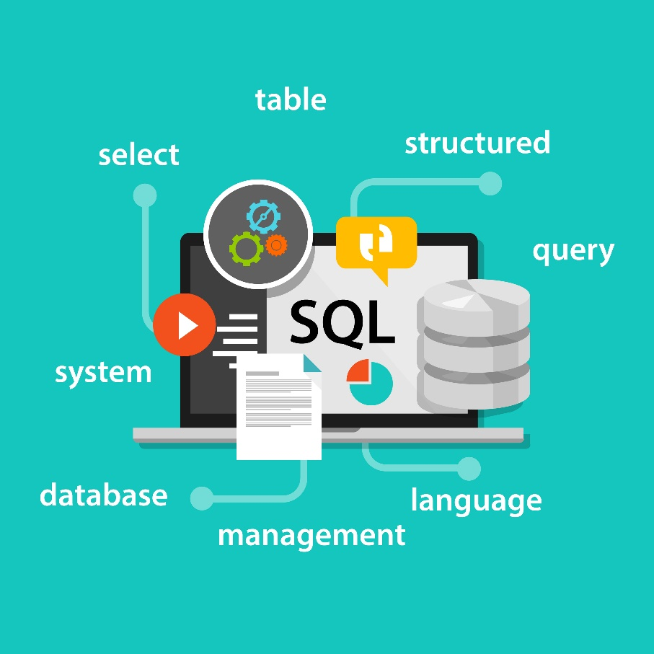
SQL Basics
SQL Syntax
Creating Tables, Columns, and Rows
Primary and Foreign Keys
Constraints

Slide 2

See Also
http://www.w3schools.com/sql/
https://technet.microsoft.com/en-us/library/bb264565(v=sql.90).aspx
Notes:
Some additional information on concurrency

Slide 3
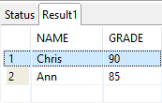
SQL Basics
SET SCHEMA APP; -- Don't do this
DROP TABLE APP.GRADES;
CREATE TABLE APP.GRADES (
name VARCHAR(20), -- up to 20 characters
grade INT -- column name and type
);
INSERT INTO APP.GRADES
(name,grade) -- columns to set
values ('Chris',90); -- values in same order
INSERT INTO APP.GRADES values ('Ann',85);
SELECT * FROM APP.GRADES; -- all columns, all rows
-- comments
Case INsensitive
Use multi-lines as needed
End commands with ;
Streams of bytes … two ways (into your program and out of your program)
Disks, consoles, sockets, keyboards, printers
Know how to talk streams and you can talk to anything
Initialization (constructor) is different. Use is the same.

Slide 4
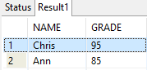
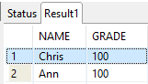
SQL Basics
SELECT * FROM APP.GRADES;
SELECT grade FROM APP.GRADES
WHERE name='Chris';
-- only rows that match 'Chris'
UPDATE APP.GRADES
SET grade=95
WHERE name='Chris';
UPDATE APP.GRADES
SET grade=100;
Streams of bytes … two ways (into your program and out of your program)
Disks, consoles, sockets, keyboards, printers
Know how to talk streams and you can talk to anything
Initialization (constructor) is different. Use is the same.

Slide 5
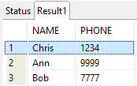
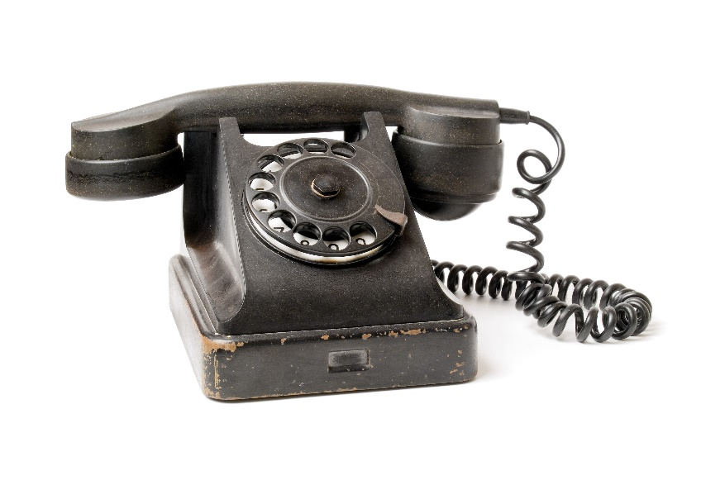
PHONES Table
CREATE TABLE APP.PHONES (
name VARCHAR(20),
phone VARCHAR(8)
);
INSERT INTO APP.PHONES values ('Chris','1234');
INSERT INTO APP.PHONES values ('Ann','9999');
INSERT INTO APP.PHONES values ('Bob','7777');
SELECT * FROM APP.PHONES;
Streams of bytes … two ways (into your program and out of your program)
Disks, consoles, sockets, keyboards, printers
Know how to talk streams and you can talk to anything
Initialization (constructor) is different. Use is the same.

Slide 6
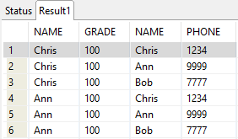
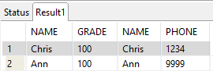
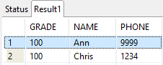
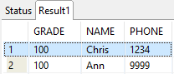
Joins
SELECT * FROM APP.GRADES, APP.PHONES;
SELECT * FROM APP.GRADES, APP.PHONES
WHERE GRADES.name = PHONES.name;
SELECT GRADES.grade, GRADES.name, PHONES.phone
FROM APP.GRADES, APP.PHONES
WHERE GRADES.name = PHONES.name;
SELECT GRADES.grade, GRADES.name, PHONES.phone
FROM APP.GRADES, APP.PHONES
WHERE GRADES.name = PHONES.name
ORDER BY NAME asc;
Streams of bytes … two ways (into your program and out of your program)
Disks, consoles, sockets, keyboards, printers
Know how to talk streams and you can talk to anything
Initialization (constructor) is different. Use is the same.

Slide 7
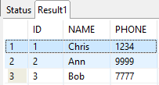

Generated Primary Keys
DROP TABLE APP.PHONES;
CREATE TABLE APP.PHONES (
id INT PRIMARY KEY GENERATED ALWAYS AS IDENTITY,
name VARCHAR(20) NOT NULL,
phone VARCHAR(8)
);
INSERT INTO APP.PHONES (name,phone) values ('Chris','1234');
INSERT INTO APP.PHONES (name,phone) values ('Ann','9999');
INSERT INTO APP.PHONES (name,phone) values ('Bob','7777');
Streams of bytes … two ways (into your program and out of your program)
Disks, consoles, sockets, keyboards, printers
Know how to talk streams and you can talk to anything
Initialization (constructor) is different. Use is the same.

Slide 8
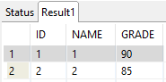
Foreign Keys
PHONES
DROP TABLE APP.GRADES;
CREATE TABLE APP.GRADES (
id INT PRIMARY KEY GENERATED ALWAYS AS IDENTITY,
name int NOT NULL REFERENCES APP.PHONES(id),
grade INT NOT NULL
);
INSERT INTO APP.GRADES (name,grade) values (1,90);
INSERT INTO APP.GRADES (name,grade) values (2,85);
INSERT INTO APP.GRADES (name,grade) values (null,75);
INSERT INTO APP.GRADES (grade) values (75);
GRADES
Streams of bytes … two ways (into your program and out of your program)
Disks, consoles, sockets, keyboards, printers
Know how to talk streams and you can talk to anything
Initialization (constructor) is different. Use is the same.

Slide 9
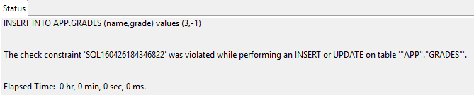
Other Constraints
DROP TABLE APP.GRADES;
CREATE TABLE APP.GRADES (
id INT PRIMARY KEY GENERATED ALWAYS AS IDENTITY,
name int NOT NULL REFERENCES APP.PHONES(id),
grade INT NOT NULL CHECK (grade>=0)
);
INSERT INTO APP.GRADES (name,grade) values (1,90);
INSERT INTO APP.GRADES (name,grade) values (2,85);
INSERT INTO APP.GRADES (name,grade) values (3,-1);
Streams of bytes … two ways (into your program and out of your program)
Disks, consoles, sockets, keyboards, printers
Know how to talk streams and you can talk to anything
Initialization (constructor) is different. Use is the same.

Slide 10

Tinkering
Use IJ or Eclipse to create the GRADES/PHONES database.
Maybe PHONES should be more generic? What name would you choose? What other info?
Add column “SUBJECT” and insert lots of grades for several students.
Run a query to find everyone who failed a “Science” test.
Notes:
Here are some things to think about … nothing to submit.
Share your thoughts in the online portal discussion area.

